Slide 1
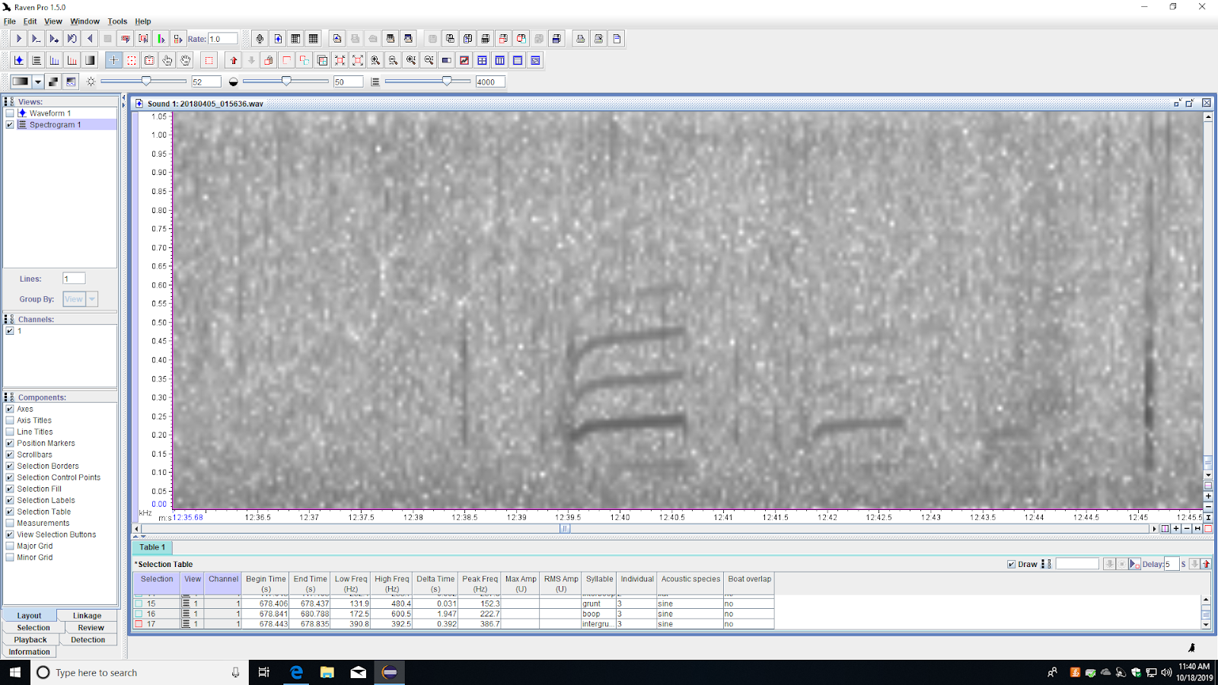
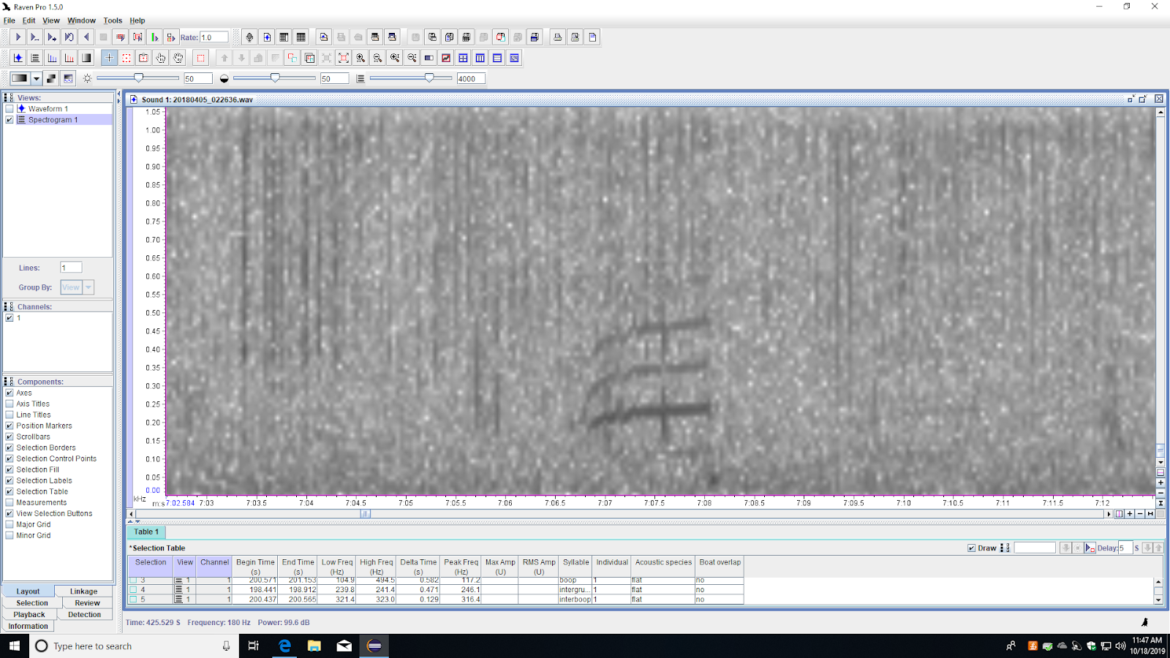
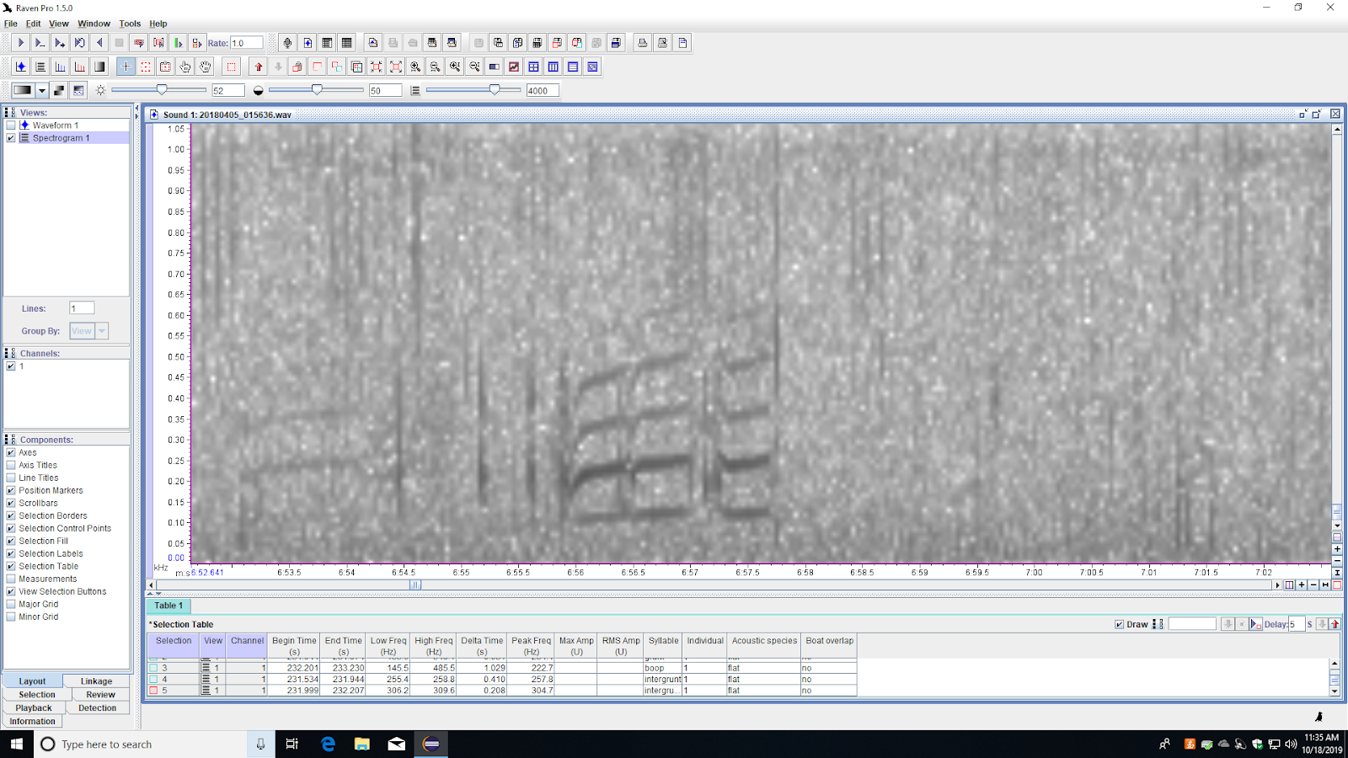
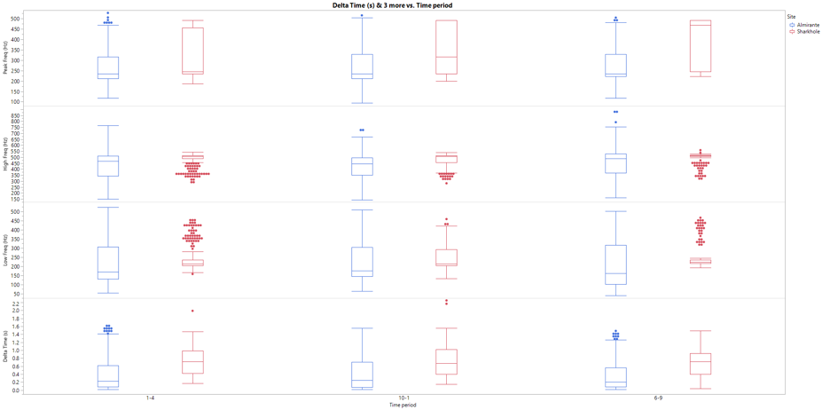
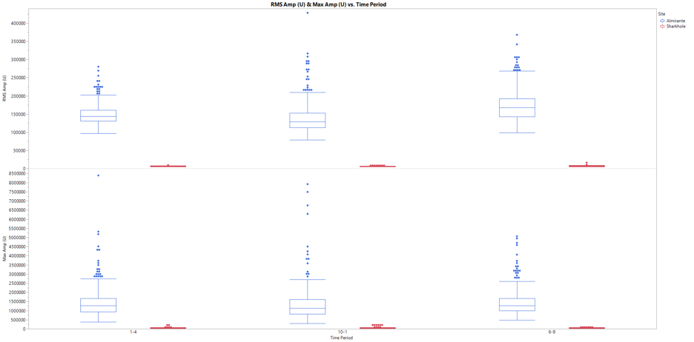

Pho
Boat Traffic in Bocas Del Toro, Panama Associated with Selection for Lower and Louder Toadfish (Amphichthys cryptocentrus) Calls.
RESULTS
Acoustic Species
Three acoustic species were identified based on contour differences of the boop; flat, flat*, sine
Flat was most commonly detected – 55%, followed by sine – 25%, and flat* - 20%
Factors Influencing Call Acoustic Structure
Toadfish call low frequency and peak frequency varied between sites and time of day
Call high frequency, call duration, and call amplitude varied between site, acoustic species, and time of day.
Flat Species Call Acoustic Structure
Calls were lower in frequency, shorter, and louder in Almirante (high boat traffic)
Call high frequency was lower in the presence of boat traffic in Almirante (10am to 1 pm)
Call frequency was higher at night (7pm to 9pm) in Sharkhole.
Emma Gagne¹ and Laura J May-Collado^{1, 2, 3, 4}
University of Vermont¹, Panacetacea², Smithsonian Tropical Research Institute³ Universidad de Costa Rica⁴
INTRODUCTION
Toadfish use acoustic communication to attract females to their burrows to spawn, and is therefore critical to their reproductive success. Their mating calls consist of low frequency “grunts” and “boops” which convey information about the male’s guarding quality to females (Staaterman et al., 2017).
A previous study by CURE students in 2018 found overall patterns in which toadfish appeared to lower their frequency and signal energy during high boat traffic time in the same region. However, these patterns could be due to different toadfish species using the same spatial space. To address this limitation, I classify ‘acoustic’ toadfish species based on the contour of the boop.
I expect the toadfish call acoustic structure will vary throughout the day and between sites (Almirante with high boat traffic, and Sharkhole with little boat traffic). I also hypothesize that if boat noise is the major driver of toadfish call structure, the above patterns should be detected in both the described acoustic species.
METHODS
Study site: Archipelago of Bocas del Toro, Panama. Coral reefs, mangroves, and seagrass habitats compose integral parts of its marine environment. (Guzman, M. H., et al. 2005).
Recordings: Passive acoustic recordings were taken with RUDAR-mk ((Sampling rate up to 96kHz -169dB re:1V/uPa) from Cetacean Research Technology. The recorder was programmed to continuously record the soundscape in segments of 30 minutes at a sampling rate of 48 kHz from March 28 to April 7, 2018. Recorders were deployed in two sites Almirante (9.289N, -82.332W) and Sharkhole (9.184N, 82.176W) at about 12 meters in depth.
Call data: Toadfish calls with good signal-to-noise ratio were selected from dawn (2am-4am), midday (11am-1pm), and dusk (7pm-9pm) to analyze their frequency and temporal characteristics. Analyses were done in Raven 1.5 (2016; Cornell Lab of Ornithology) with a Fast Fourier Transform size of 4,000 points, an overlap of 50%, and a 4096-sample Hann window.
Statistics: A generalized regression analysis is used to determine the contribution of acoustic species, time of day, and site to the call acoustic structure. An ANOVA test was done to determine if acoustic species found in both low and high boat traffic sites significantly vary in call acoustic structure. The statistical analyses were done using JMP Pro 14.2 (SAS, 2019)
FIG 2. The spectrogram of the three acoustic species are shown. From left to right; species flat, species sine, and species flat*.
Photo by Erica Staaterman
Toadfish boatwhistle calls are shorter in duration, lower in frequency, and higher in amplitude in sites where boat traffic (anthropogenic noise) is higher.
FIG. 3: Box plot comparison of call parameters between Almirante and Sharkhole throughout the day (1 am-4 am, 10 am-1 pm, and 6 pm - 9pm), . Top row shows peak frequency (Hz), second row shows High frequency (Hz), third row shows low frequency (Hz), and the bottom row shows delta time (s).
FIG 1. Archipelago of Bocas del Toro, Panama.
Image credit: UCI Panama
Photo by National Geographic
FIG. 4: Box plot comparison of call parameters between Almirante and Sharkhole throughout the day (1 am-4 am, 10 am-1 pm, and 6 pm - 9pm), . Top row shows RMS amplitude and the bottom row shows maximum amplitude.
CONCLUSIONS
Only the “flat” species was found at both sites.
The “acoustic adaptation hypothesis” states that efficient communication in contexts of mate choice or attraction is predicted to enhance Darwinian fitness of the individuals making the call.
Toadfish capable of making lower frequency to avoid masking from the boats will experience greater fitness according to this hypothesis.
Potential for phenotypic change along with call change; swim bladder size increases with lower frequencies, which could therefore cause greater body size in toadfish able to produce lower calls.
Photo by Erica Staaterman
Photo by Erica Staaterman
Acknowledgements
Special thanks to Dr. May-Collado for her support and guidance in this project, as well as her work on the statistical analyses. Additional thanks to Betzi Perez for access to her recordings

